Slide 1


Fertility-Sparing Surgery of
Borderline Ovarian Tumors
Philippe Morice, MD
Institute Gustave-Roussy
Villejuif, France

Slide 2
Characteristics of Borderline Ovarian Tumors (BOT) Compared To Ovarian Cancers
Age of patients: 30% of patients are <40 y
Prognosis
FIGO stage N 5-year relative 10-year relative
survival (%) survival (%)
I 2310 99 97
II 158 98 90
III 228 96 88
IV 87 77 69
NCI DATABASE Trimble et al. 2002

Slide 3
Conservative management of BOT increases the risk of recurrent disease compared to radical surgery
Recurrences
Radical : 0%-5%
Conservative: 10%-30%

Slide 4
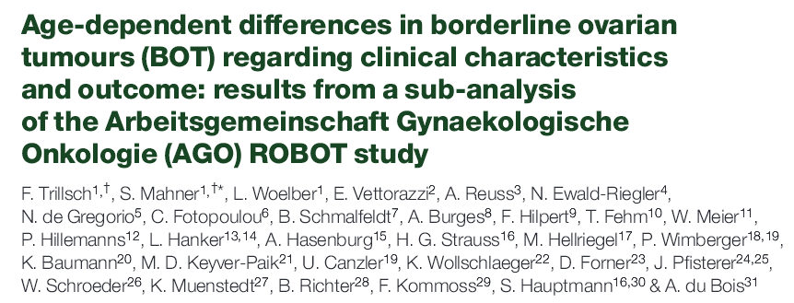
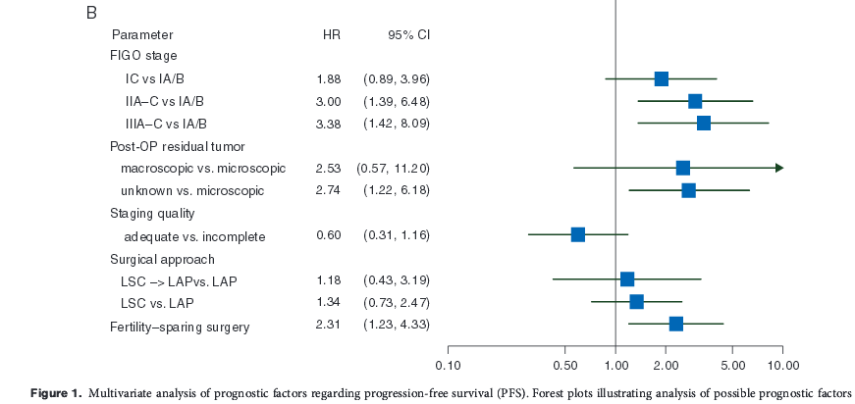
Ann Oncol. 2014;25(7):12320-1327.

Slide 5
Survival According to the Type of the Surgical Treatment
n, recurrence 10-year DFS Deaths
Radical 9 /175 92% 5/175
Conservative 9 /184 95% 1/184
Park JY, et al. Gynecol Oncol. 2009;113(1):75-82.
DFS
Radical 100%
Conservative 99.3% (for stage I)
Zanetta G, et al. 2001.
Type of surgery doesn’t influence the survival (Zanetta 2001, Morice 2001, Park 2009). This is explained by the fact that most recurrences were borderline disease and not invasive carcinoma. Rate of recurrence under the form of invasive carcinoma <1% (in stage I disease)

Slide 6
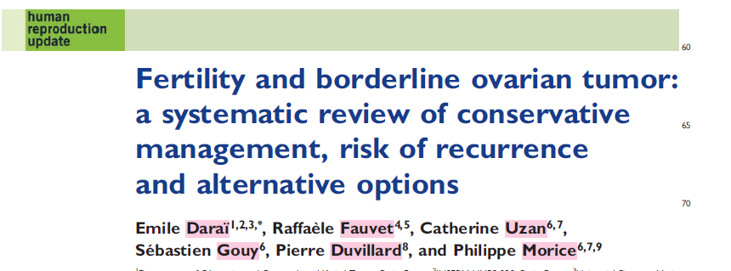
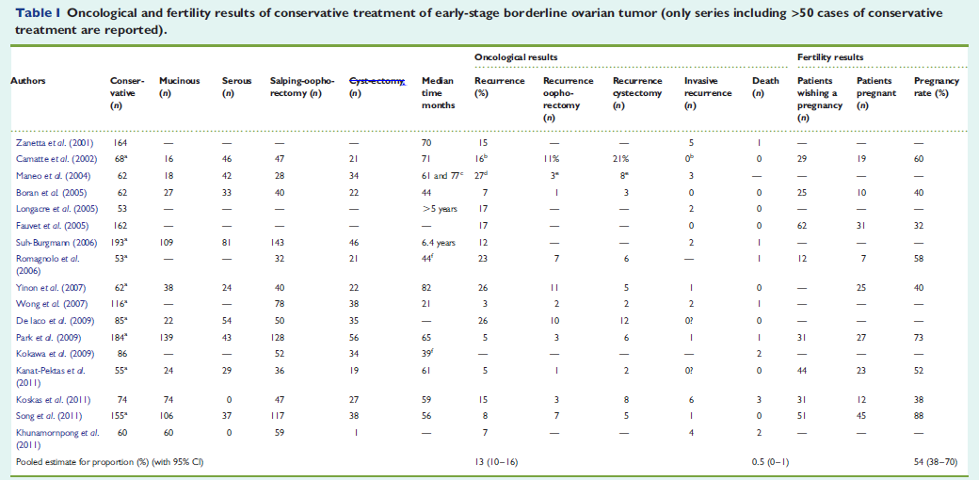
Daraï E, et al. Human Reprod Update. 2013;19(2):151-166.

Slide 7
Recurrence Death
Pooled estimate for proport (CI95%) 13 % (10-16) 0.5% (0-1)
Daraï E, et al. Human Reprod Update. 2013;19(2):151-166.

Slide 8
Serous BOT (Most Frequent)
epithelial
noninvasive = 88 % desmoplastic
Serous ➔ implants
(10%-40%) invasive = 12 %
➔ Bilaterality: 25%-35%
➔ Micropapillary pattern (described since 1996):
  - (infraclinic) implants (invasive or noninvasive) more frequent than in serous BOT without nonmicropapillary patterns
  - Bilaterality of the ovarian tumor more frequent
  - Involvement of the ovarian surface (excrescence) more frequent

Slide 9
Mucinous BOT
Complex group of tumors. Evolution of the histologic classification
Bulky tumors >15 cm +++. Question of the histologic sampling
Late recurrence under the form of invasive carcinoma recently reported 8%
Uzan et al (2013). Single prognostic factor of recurrence: cystectomy +++
Intestinal (most frequent)
- 98% unilateral (if bilateral: exploration of GI tract)
Mucinous - Peritoneal spread exceptional
      Mullerian or endocervical (now « seromucinous » in WHO 2013)
      - Association with endometriosis and/or others subtypes of BOT
      - Could be bilateral
      - Could be associated with peritoneal implants
      (mixed histology)

Slide 10
Unilateral Tumor
Cystectomy Or Oophorectomy?
Rate of recurrence « conventionally » increased in many papers after cystectomy (compared to salpingo-oophorectomy)
But recent series don’t report this increased rate (Yinon 2007; Park 2009)
In cases of unilateral tumor: salpingo-oophorectomy is the standard management
    Required in mucinous BOT (but macroscopic aspect is different from SBOT)
    « Preferred » in case of micropapillary SBOT (this pattern could be diagnosed « only » at the time of permanent histologic examination)

Slide 11
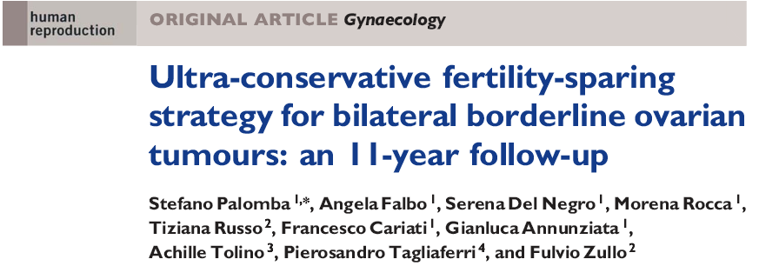
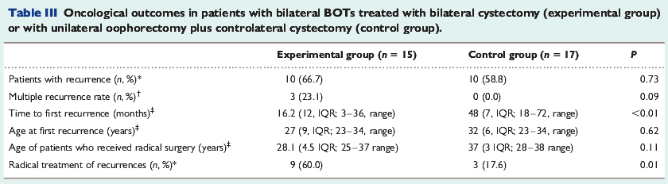
Palomba S, et al. Human Reprod. 2010;25(8):1966-1972.

Slide 12
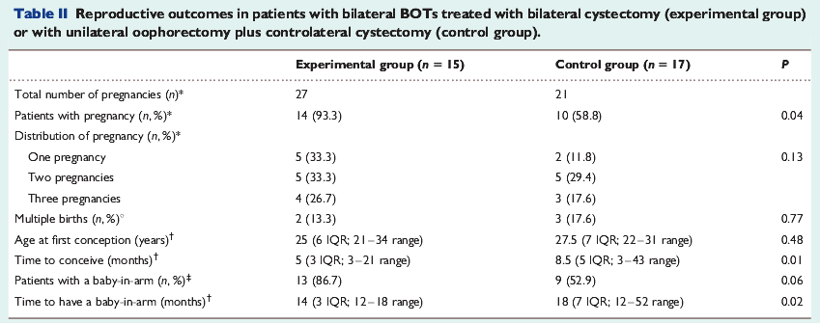
Palomba S, et al. Human Reprod. 2010;25(8):1966-1972.

Slide 13
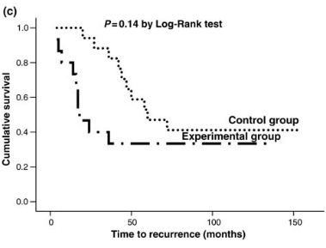
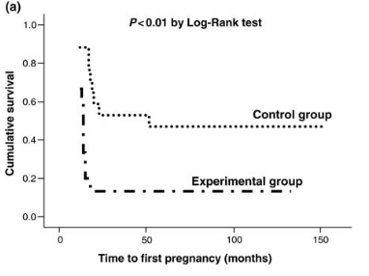
Bilateral cystectomy preferred (if technically feasible)
Palomba S, et al. Human Reprod. 2010;25(8):1966-1972.

Slide 14
Specific Management of SBOT With Peritoneal Implants

Slide 15
Histologic Subtype Of Implants (Serous Tumors)
Series With >50 Patients
Died, noninvasive implants
Died, invasive implants
n
Bell 1988 56 3/50 5/6
Seidman 1996 65 1/52 6/13
Gershenson 1998 112 6/73 6/39
I.G.R. 2008 168 3/138 2/21
Longacre 2005 113 2/85 5/14
TOTAL 514 15/398 (3.7%) 24/83 (29%)

Slide 16
Conservative Treatment In Stage II/III Serous Bot
n, recurrence n, death
Zanetta et al 2001 10 (on ovary/perit or nodes) 0
n = 25
Uzan & Morice 22 (11 on ovary/11 peritoneum) 1 (noninv impl)
n = 41
Prat & De Nictolis 3 (2 on ovary/1 peritoneum) 1 (inv impl)
n = 10
Longacre et al 2005 5 (on ovary) 0
n = 21
Park et al 2009 1 (on ovary) 0
n = 3
High rate of recurrence
Location of the recurrence: peritoneum
No (or little?) impact on the survival

Slide 17
Fertility Results and Management Of Infertility

Slide 18
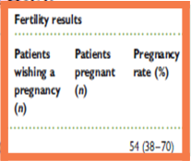
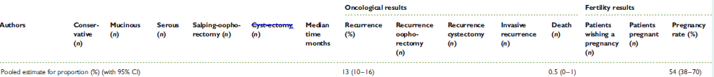

Slide 19
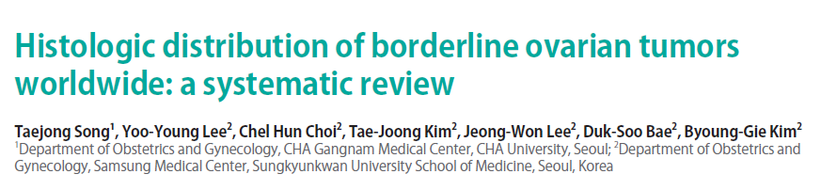
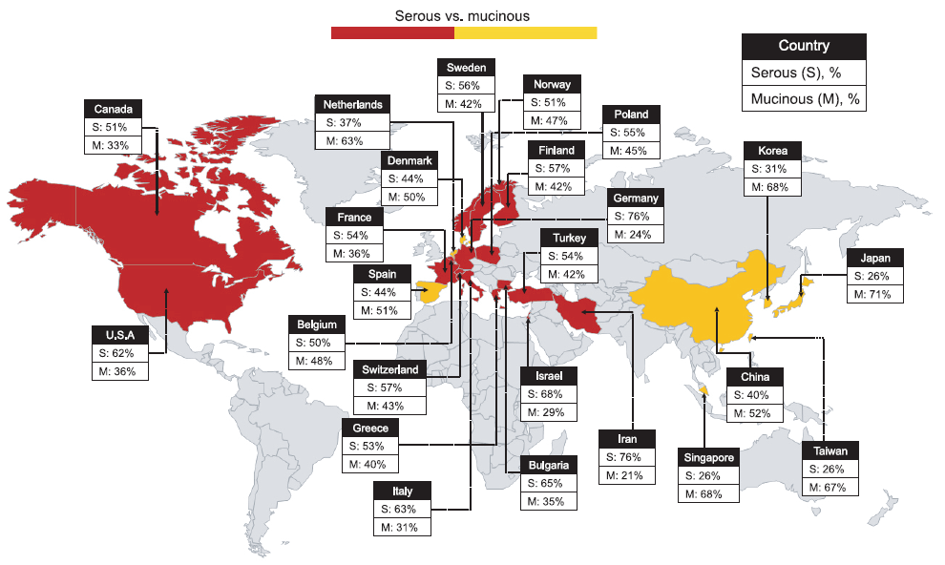
Song T, et al. J Gynecol Oncol. 2013;24(1):44-51.

Slide 20
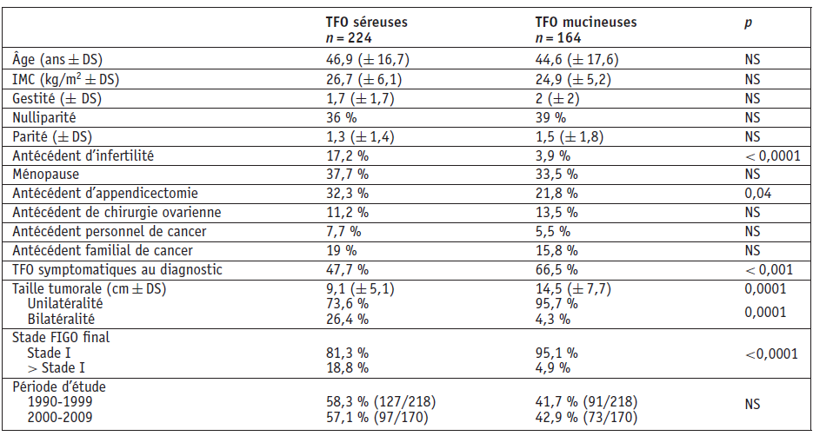
Fauvet et al. 2012
Epidemiologic Characteristics: BOTs vs Serous Ovarian Tumors
Fauvet R, et al. Bull Cancer. 2012;99(5):551-556.

Slide 21
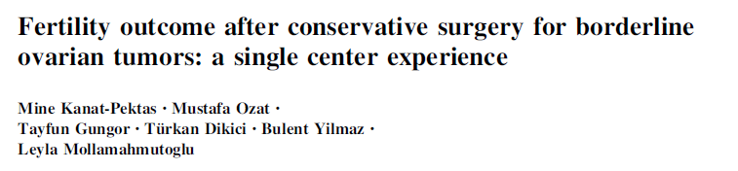
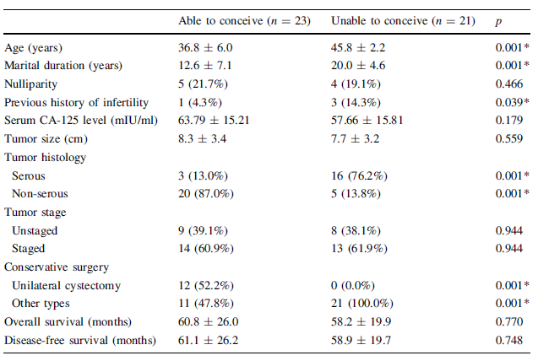
Kanat-Pektas M, et al. Arch Gynecol Obstet. 2011;284(5):1253-1258.

Slide 22
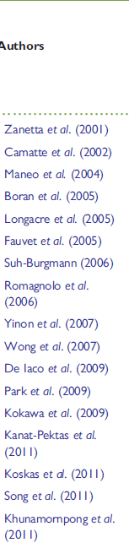
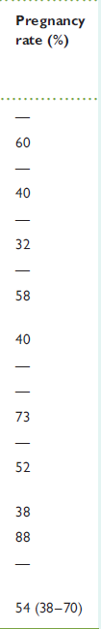

Slide 23
Infertilty Treatment in Patients
With Previous History of BOT
N, pts N, IO/IVF Pregnancy Recurrence
Hoffman 1999 1 stage II/III 1 IVF 1 0
Nijman 1992 1 stage II/III 1 IVF 1 0
Mantzavinos 1994 2 stage II/III 2 IVF 1 0
Hershkovitz 1998 2 stage II/III 1/1 2 (1 spontan. after IVF) 0
Beiner 2001 7 (2 stage II/III) 0/7 5 2
Fasouliotis 2004 5 (stage I) 0/5 3 2
Fauvet 2005 11 (1 stage II) 6/5 3 ?
Madelenat 2007 30 (8 stage II/III) 3/27 13 4
Park 2007 5 (1 stage I) 5 IVF 4/8 cycles 0

Slide 24
French Multicenter Study
30 Patients
3 simple ovarian stimulation and 27 IVF
Mean number of cycles: 2.6 (1-10)
Mean time of FU: 93 months (after the TT of the BOT) & 42 months after the ovarian stimulation
20 stage I, 4 stage II, 4 stage III (noninvasive implants) & 2 stage ?
5 patients having IVF « in emergency » with tumor « in place » (recurrent disease on a single ovary - previous history of oophorectomy)

Slide 25
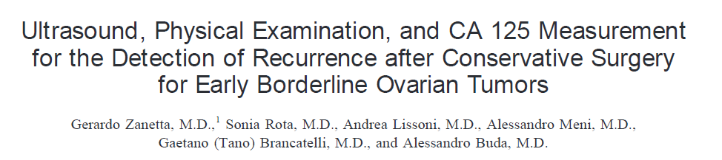
164 stage I treated conservatively
Clinical exams + US (transvaginal if feasible) every 3 mths/2 years, and every 6 mths thereafter
Blood markers: CA 125/6 mths for serous BOT
Median time of follow-up 71 months
28 (17%) recurred
  Data on follow-up characteristics in 24
    5 invasive recurrence
    19 borderline recurrence
Zanetta G, et al. Gynecol Oncol. 2001;81(1):63-66.

Slide 26
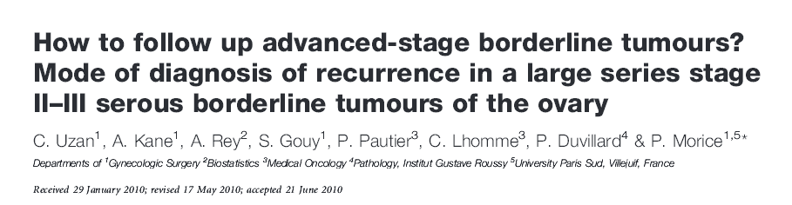
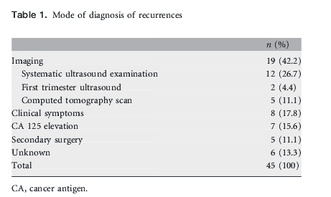
Uzan C, et al. Ann Oncol. 2011;22(3):631-635.

Slide 27
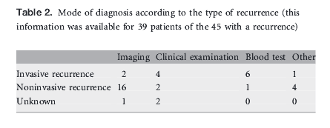
Uzan C, et al. Ann Oncol. 2011;22(3):631-635.

Slide 28
Follow-Up in Stage II/III (S)BOT
Clinical examination
CA 125
Imaging:
  Abdominopelvic US (in pts treated conservatively)
  US or abdominopelvic CT scan and/or MRI in pts treated radically?
    Depending on the spread of the disease
At least 3/year during the 3 first years, 2/year between 3 & 5 years, and yearly thereafter
Length?

Slide 29
Conclusions (BOT)
Large indication of conservative surgery in stage I
No completion surgery after childbearing (but long follow-up +++)
Fertility rates between 30% and 80%
In advanced stage disease removal of all peritoneal implants is the first goal
Conservative surgery could be discussed in selected cases of patients with non-invasive peritoneal implants

